Slide 1

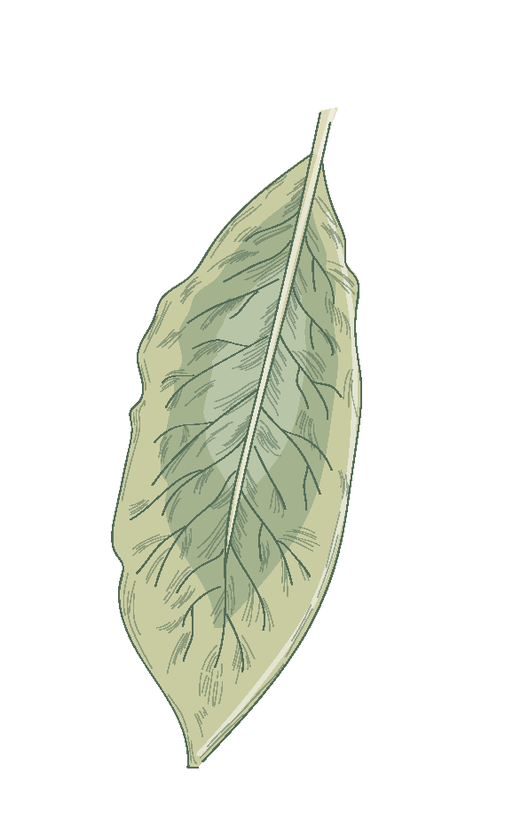


SWS-3009 Cluster3-3 Lovely Sparky
BY group “overfitting loop”
LUO HAOYU
LIN HANQI
SUN YIQING
HE YUXIN
ZHANG CHENYU

Slide 2

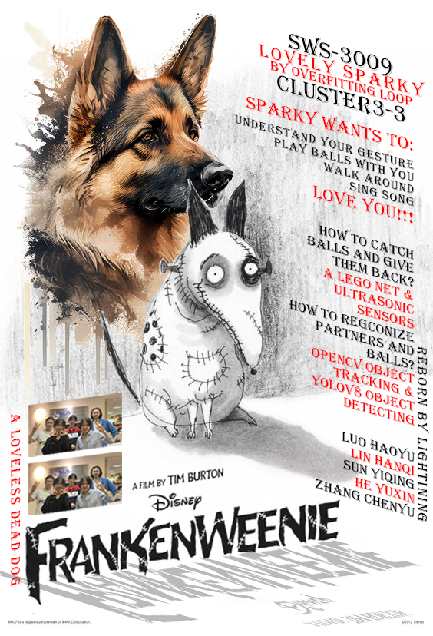

WHAT OUR ROBOT CAN DO
Our robot is a puppy, his name is sparky, his prototype comes from the Disney animation movie Frankenweenie, it can :
Understand you gestures
Find a ball and pick it back
Walk around and sing songs
Although he has just been revived by electric shock and his movements are clumsy, he will try his best to complete the tasks assigned to him by his partners.

Slide 3
PROBLEM WE SOLVED
BALL DETECT
GESTURE RECOGNIZE
HUMAN DETECT

